Slide 1
Library Management System (LMS) – Capstone Project
Full Stack Web development project
Presented by: ler tuck guan
Date: 1st April 2025

Slide 2
Project Overview
The Library Management System is built to offer a user-friendly web-based platform for both library member and library staff to manage library operations. This system enables library members to search for books, borrow and return them, view borrowing history and receive notifications about overdue items. The system enables library staff to do additional functionality, manage the book and user records(add, edit, delete).
This is a full stack development using Spring Boot for backend, MySQL as our database management system and REACT for the frontend.

Slide 3
Project Goals
The System must be fully functional for both users and staff, and scalable
Provide administrative functions for managing books and members (create, update, delete)
Allow users to borrow and return books in the library
Allow users to track their borrowing history
The System must be user friendly and intuitive to enhance user experience
The System must be accessible by users anywhere, on any device to register, login and search for books
The System must be platform independent

Slide 4
Key Features
Staff Admin functions
User Management
Book Management
Circulation (borrow and return)
Generate notifications automatically
User functions
Log in
Sign up
Search for books
Receive notifications

Slide 5
Business Rules
In-progress

Slide 6
Technical Requirements
Backend
Spring Boot: A streamlined, convention-over-configuration framework that significantly reduces boilerplate code and simplifies application setup.
RESTful API: Spring Boot enable quick development of scalable web services with its starter dependencies and annotations like @RestController, @GetMapping, @PostMapping
Spring Security: Provides robust authentication, role-based access and data encryption.
JPA/Hibernate: Simplifies database operations
Frontend
React.js: Component-based architecture such as React Router, React Hooks, and Axios which is used extensively in this project.
Database
MySQL: Reliable, scalable, relationship mapping, indexing and data validation

Slide 7
System Architecture
The System is developed using Model-View-Controller (MVC) architecture for the backend
Clean and organized code development
Easy maintenance
Scalable
Model handles data logic and storage
View manages user interface presentation
Controller is an intermediary between Model and View

Slide 8
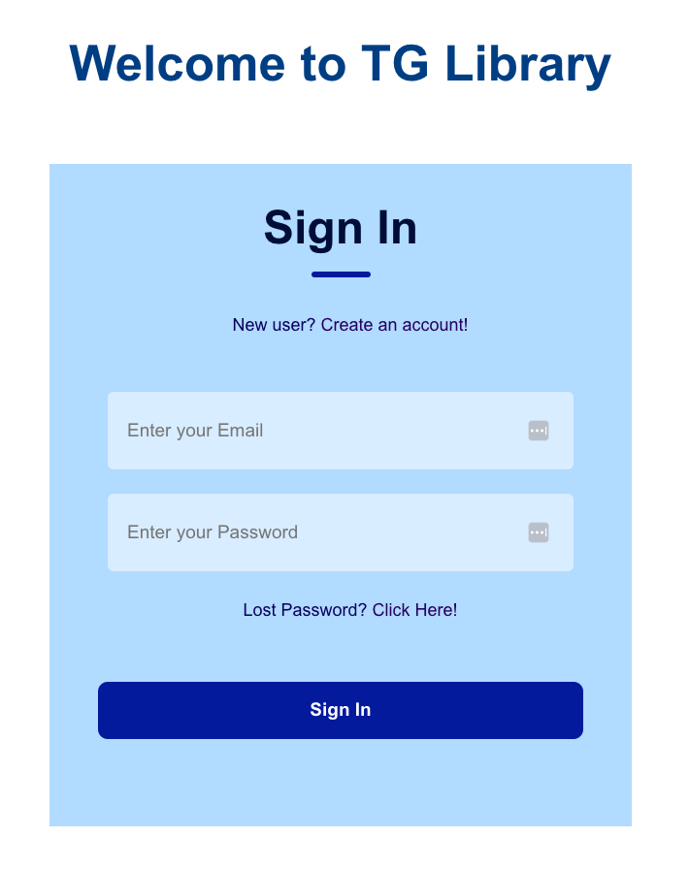
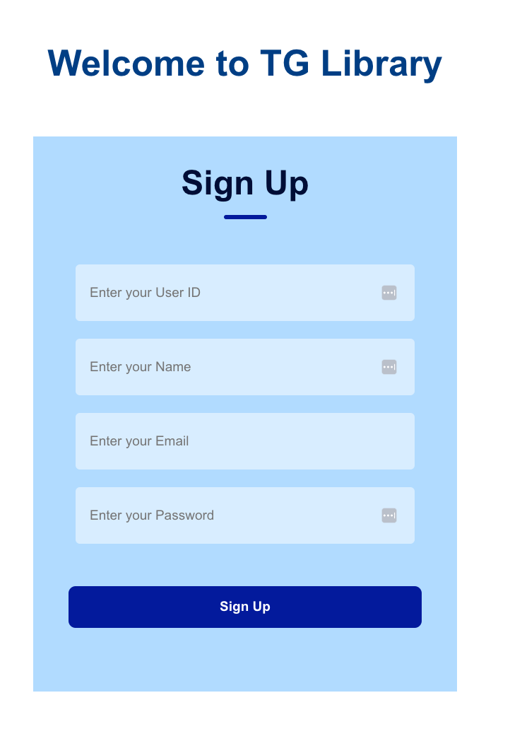
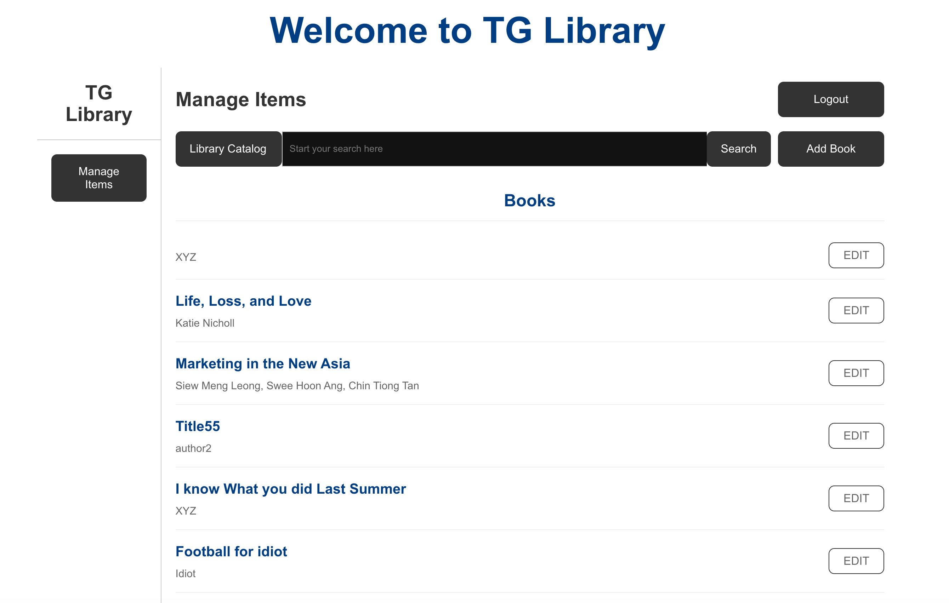
Screenshots of key features

Slide 9
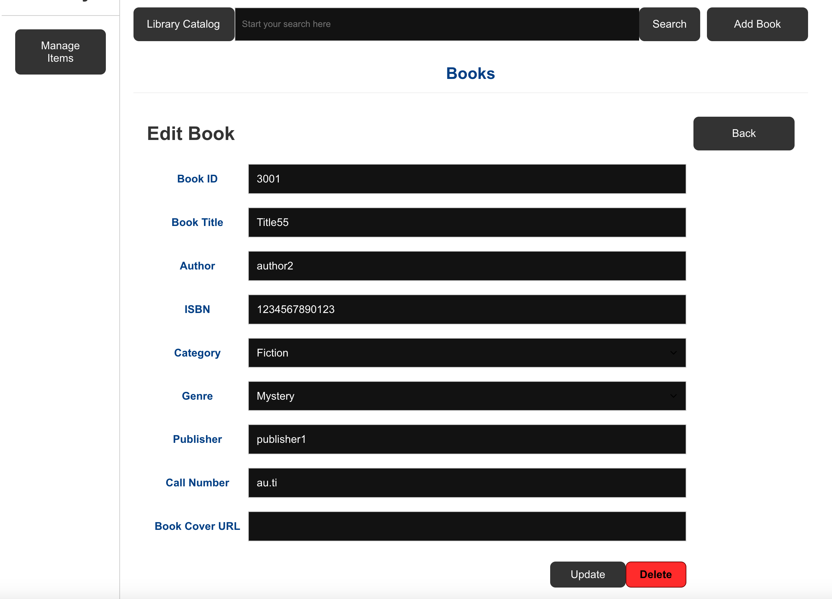
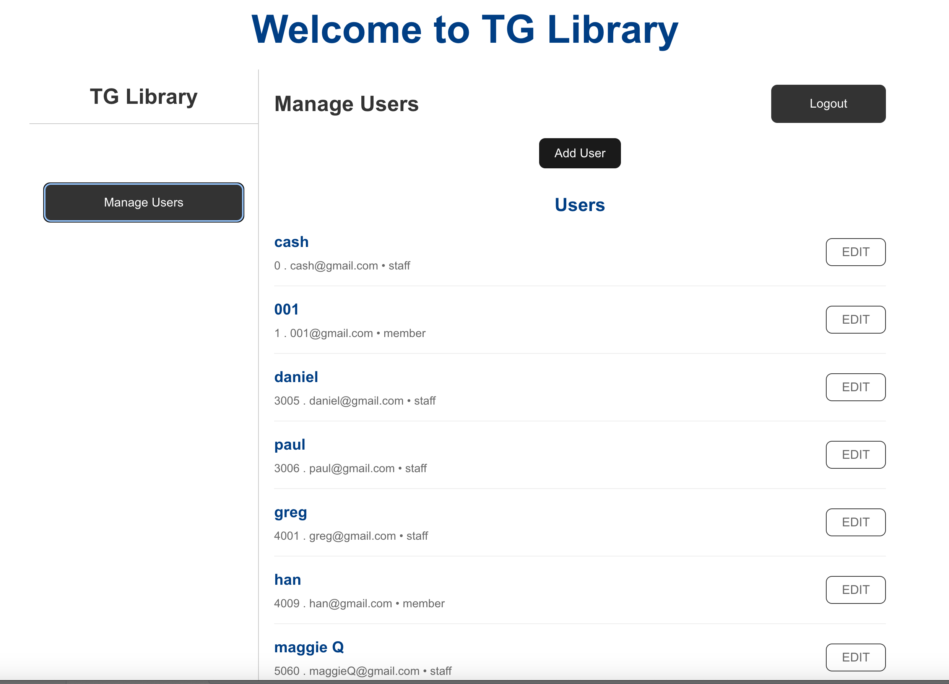
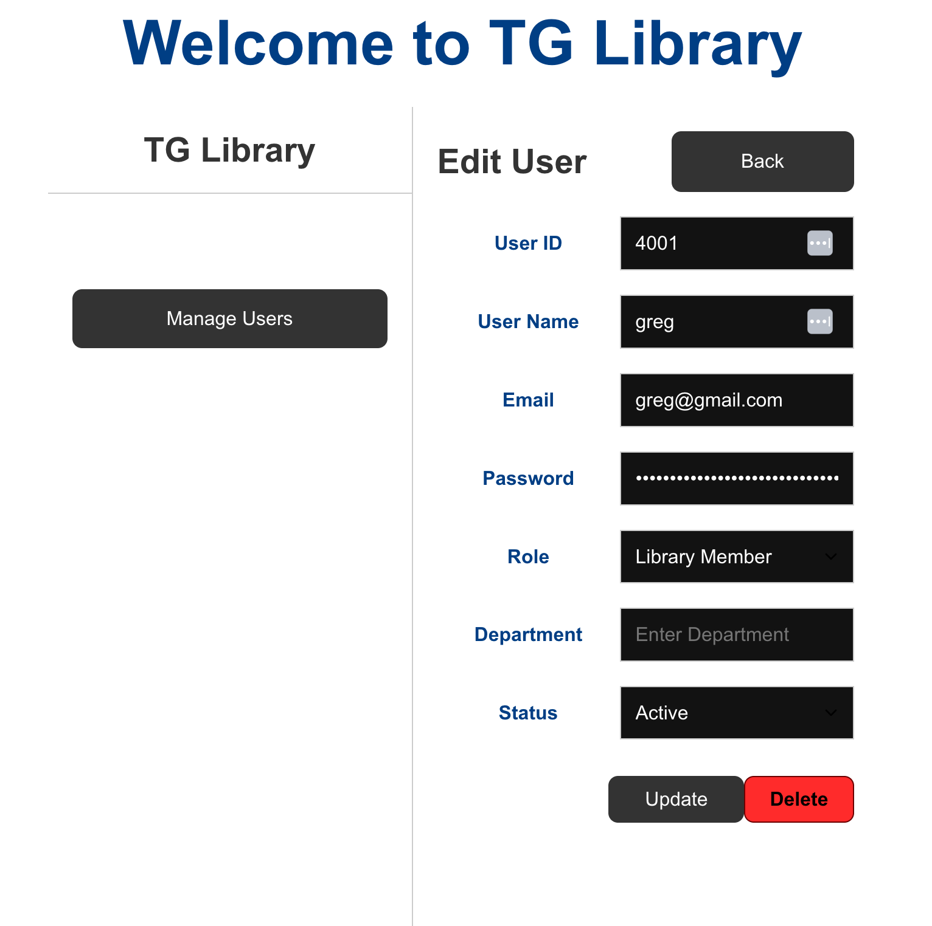
Screenshots of key features

Slide 10
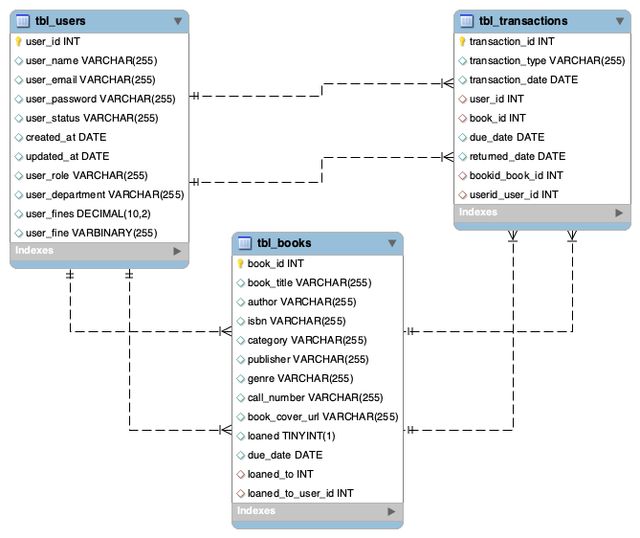
Database & System Designs
tbl_users – Store user data including its status with user-id as primary key. No foreign key
tbl_books – Store the book records with one foreign key
tbl_transactions – Store all the borrow and return transactions with two foreign keys

Slide 11
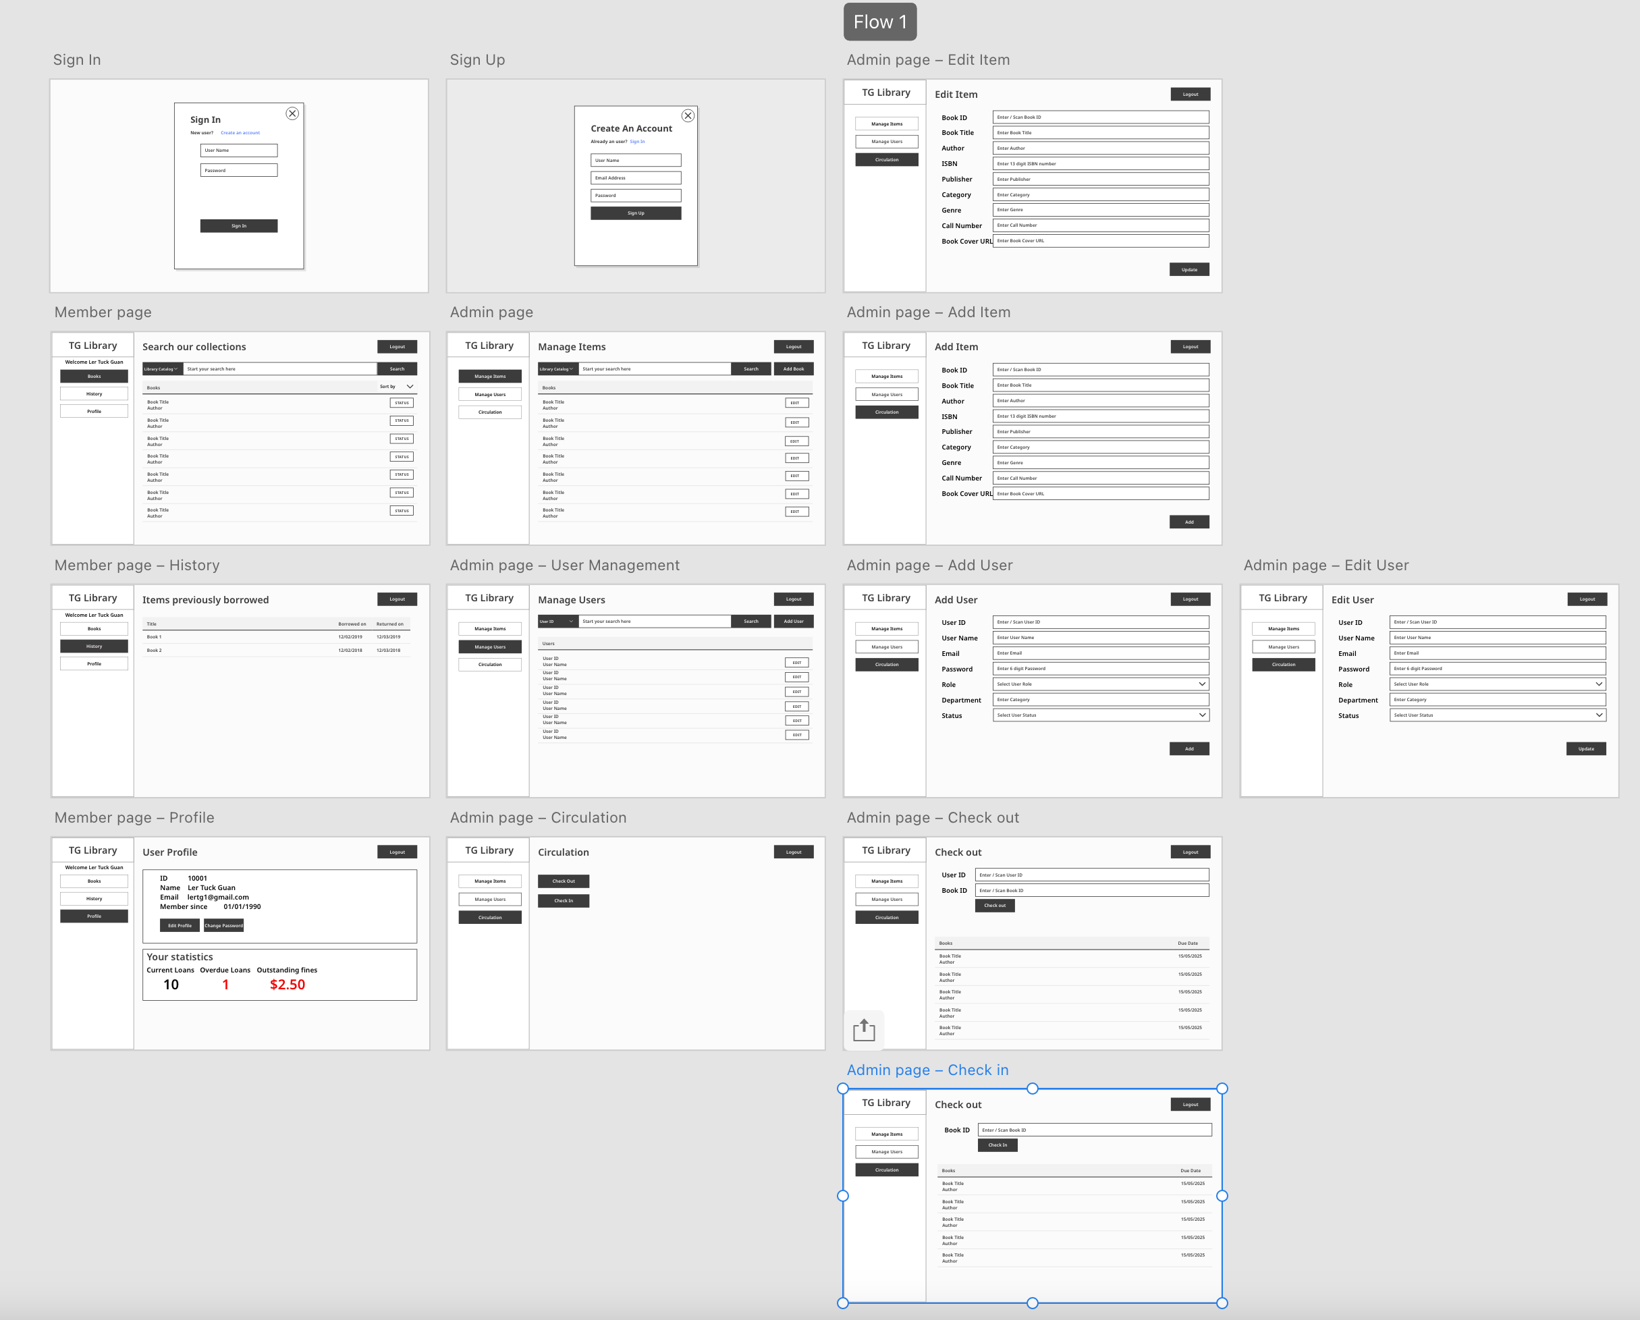
Database & System Designs

Slide 12
API endpoints
POST
/books – Add a new book in Book Management
/users – Add a new user in User Management
/auth/register – user Sign up
/books/${bookId}/borrow/{id} – borrow a book in Circulation
/auth/login – user or staff login
DELETE
/users/{id} – delete a user by Id in User Management
/books/{id} – delete a book by Id in Book Management
GET
/books – get all books in Book Management
/users – get all users in User Management
/users/email/{email} – get a user by email in Login, Sign up and User Management
PUT
/books/{id} – update a book by Id in Book Management
/users/{id} – update a user by Id in User Management

Slide 13
Challenges and Solutions
Challenges | Solutions
Debugging codes generated by AI for the Frontend | Write the codes line by line or piece by piece to avoid debugging too many errors
Implementing Spring Boot security | Not implementing Spring Boot Security too early in the development stage
Encryption of user password | Seek AI help
Building the frontend from scratch | Draw the wireframe UI to have a clearer picture on web page layout and flow
Debugging errors using Inspect (too cluttered and not user friendly) | Keep the VS Code running to see instant changes on the browser when coding. Seek AI help in debugging the errors.
Unsure about the industrial best practices in full stack software development | Seek AI help but it can be backfired

Slide 14
Future Enhancements
To add book reservation system
To externalized the assets and configuration parameters and library policies setting
To scale up for multiple branches
Integration with third-party APIs
Include statistics and report generation
Incorporate AI in the system for enhanced user experience
Manage all other library assets including room booking, PC, games, etc.
Mobile app for user sign-up, login, browsing, mobile check-out, notifications, reservations, room booking, etc

Slide 15
Conclusion
Full stack software development is a step by step process. A well-thought design and planning is important than jumping straight into the coding process.
AI is helpful in solving or suggesting solutions to the problems or errors in the codes
The project allows me to see how data flows from database to the frontend and how they are being connected by just a few lines of codes and this is amazing.
Scrapped the entire frontend code-base generated by AI and able to build the login, sign up, book management, user management frontend within 4 days.

Slide 16
Q & A

